Slide 1


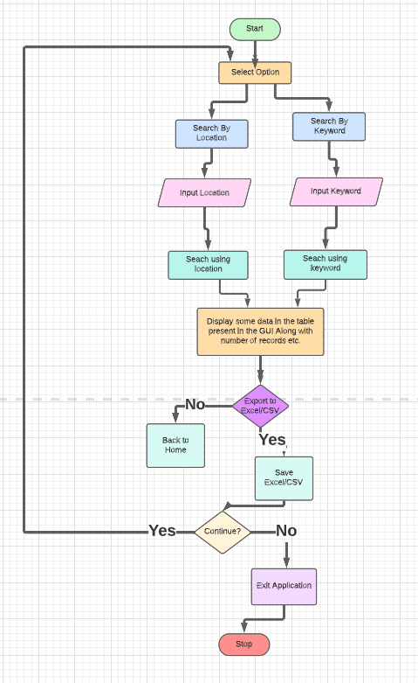
Program: Information Technology
Project Title: Maps Scraper
Domain: Artificial Intelligence Guide: Er. Sridevi Taradi
Name of Students: 19202A0047 : Shourish Kothawale
19202A0011 : Shubham Jadhav
19202A0006 : Piyush Nirbhavane
19202A0054 : Shishir Nath
Flowchart
Abstract:
Information is paramount nowadays and is seemingly growing day by day. If correct information is delivered quickly, it can be a highly effective in situations. New technology is being discovered daily to deliver data as quickly and efficiently as possible. To provide a solution to this problem we will create a data/web scraper for Google Maps for providing different kinds of data like name, phone, website etc.
Applications:
Lead Generation
Training and Testing Data for Machine Learning Projects

